Slide 1



Robotics & Automation Systems
Module 7
Electronics for Arduino Programming
(Part 1)
Capacitors, Inductors, Diodes, LEDs & PWM
PRESENTED BY
DATE OF SESSION
Course Faculty
July 2026

Slide 2


Student Capabilities after Module 7
By the end of this intensive module, undergraduate students will possess a comprehensive understanding of foundational electronic components and their direct application in Arduino-based robotics.
Component Classification: Accurately distinguish between passive components (resistors, capacitors, inductors) and active components (diodes, transistors, integrated circuits) within a schematic.
Operational Principles: Articulate the precise mechanics of energy storage in both electric fields (capacitance) and magnetic fields (inductance), including transient charging and discharging behaviors.
Semiconductor Fundamentals: Analyze diode and LED characteristics, specifically identifying forward bias conditions, reverse bias blocking, and breakdown voltage thresholds.
Mathematical Application: Execute accurate current limiting calculations using Ohm's Law to protect delicate semiconductor components like Light Emitting Diodes from thermal runaway.
Signal Modulation: Master Pulse Width Modulation (PWM) duty cycle voltage scaling to simulate analog outputs, enabling precise control over motor velocities and LED luminosity using digital microcontrollers.
Module 7: Electronics for Arduino Programming | Robotics and Automation Systems

Slide 3

Electronics in Robotics
The Nervous System of Robotics
Electronics form the critical bridge between the computational logic of an Arduino (the brain) and the physical environment. While software dictates the 'decision-making' process, electronic components act as the nervous system, translating digital commands into physical actions and converting environmental stimuli into readable data.
The Role of Electronics: In robotics, electronic circuits are essential for sensor interfacing (reading environmental variables like light, temperature, and distance) and power actuation (driving motors, relays, and displays).
Bridging Software and Hardware: An Arduino pin outputting a 'HIGH' signal is merely a 5-volt electrical potential. Without understanding how that voltage interacts with physical components, you cannot safely drive a motor or read an analog sensor.
Component Interdependence: We rely on passive components to filter noise and stabilize power, while active components switch and route high-current loads safely. Mastering this interplay prevents catastrophic hardware failures, such as burning out microcontroller pins due to excessive current draw or inductive voltage spikes.
Introduction of Electronics | Robotics and Automation Systems

Slide 4
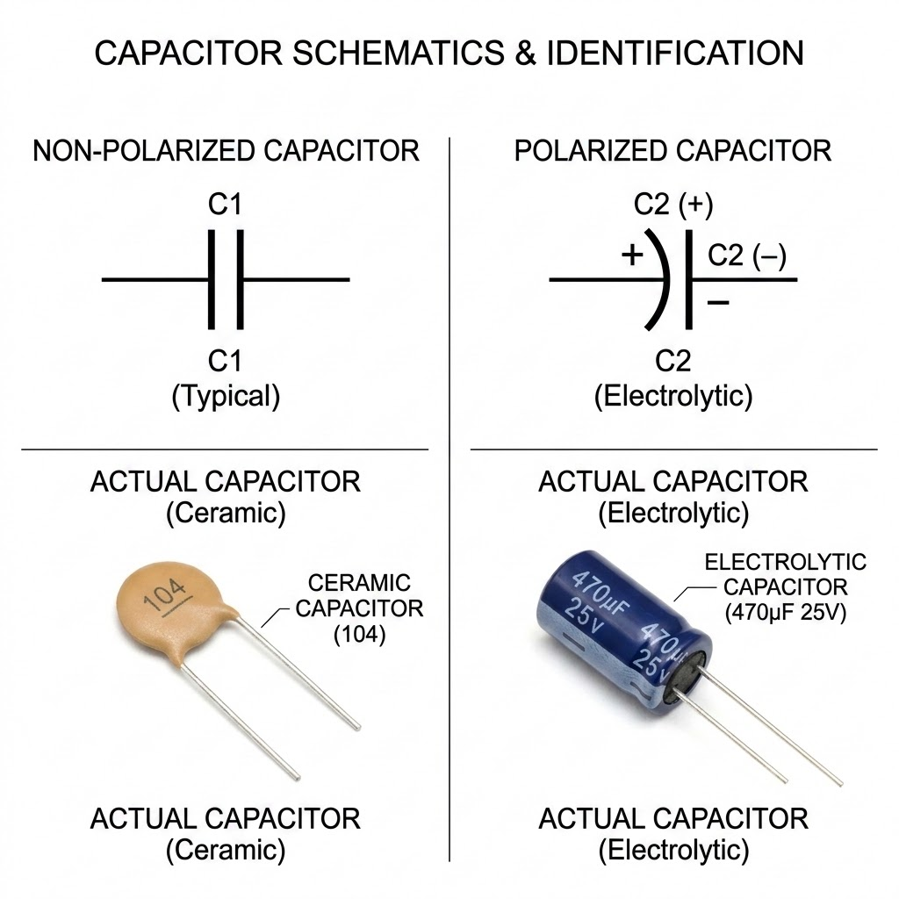
Introduction to Capacitors
1. Component Definition
A capacitor is a fundamental passive electrical component specifically designed to store and release electrical energy.
Unlike a battery that generates energy through chemical reactions, a capacitor stores energy electrostatically within an electric field established between two conductive plates separated by an insulating material known as a dielectric.
2. Capacitance & Farad Units
The capacity to store electrical charge is denoted by Capacitance (C). The standard unit is the Farad (F). Because a full Farad is an immense amount of charge, practical electronics utilize fractional units:
Microfarads (F): 1 10-6 F
Nanofarads (nF): 1 10-9 F
Picofarads (pF): 1 10-12 F
3. Circuit Symbols & Polarity
Arduino Note: Typical capacitor values used in Arduino circuits range from 1 pF to 1000 F.
Capacitors are represented by two parallel lines. Non-polarized capacitors (ceramic types) can be inserted in any direction. Polarized capacitors (electrolytic types) feature one straight line (positive) and one curved line (negative) and must be connected with correct polarity to prevent explosion.
Module 7: Electronics for Arduino Programming | Robotics and Automation Systems

Slide 5
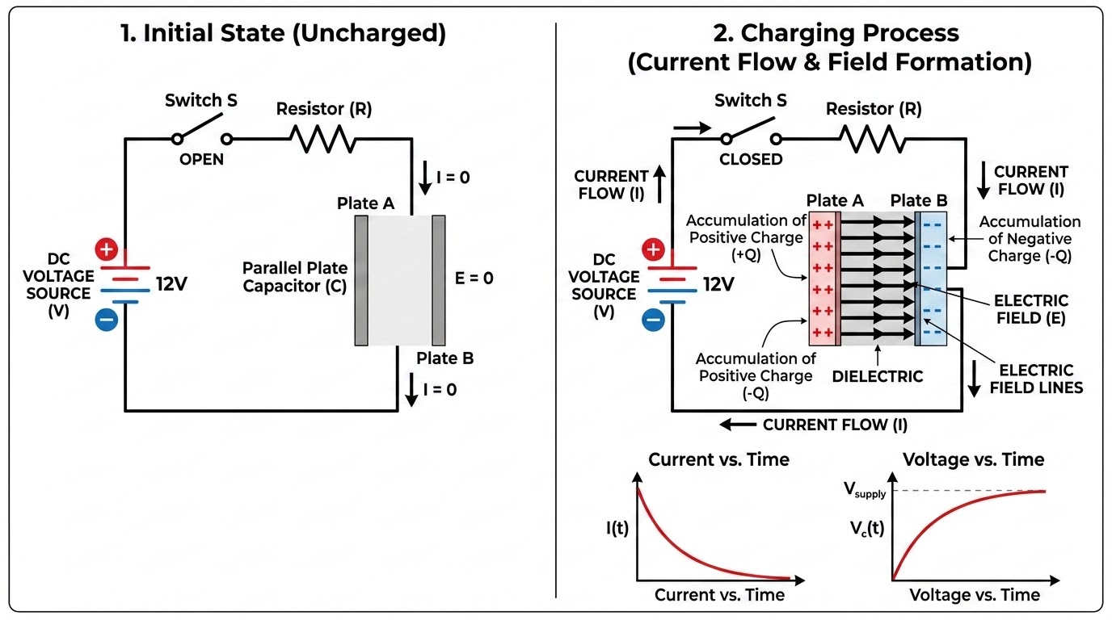
Working Principle of Capacitors: Charging, Discharging & AC/DC Behavior
Behavior in DC Circuits
Behavior in AC Circuits
In a Direct Current (DC) circuit, a capacitor initially acts as a short circuit while charging.
Once fully charged, it acts as an open circuit, completely blocking the flow of continuous DC current.
This makes them excellent for isolating different stages of a circuit.
In Alternating Current (AC) circuits, the continuous reversal of voltage causes the capacitor to constantly charge and discharge.
Consequently, it appears to allow AC signals to pass through, making it ideal for filtering out high-frequency noise.
Operational Mechanics & Cycles
The operational mechanics of a capacitor revolve around its ability to accumulate and discharge electrons rapidly. When a voltage source is applied, electrons gather on the negative plate, repelling electrons from the positive plate, storing energy in an electric field.
Charging & Discharging: A capacitor charges exponentially until its internal voltage matches the supply voltage. When the supply is removed, it discharges, acting as a temporary power source to smooth out voltage drops.
Module 7: Electronics for Arduino Programming | Robotics and Automation Systems

Slide 6
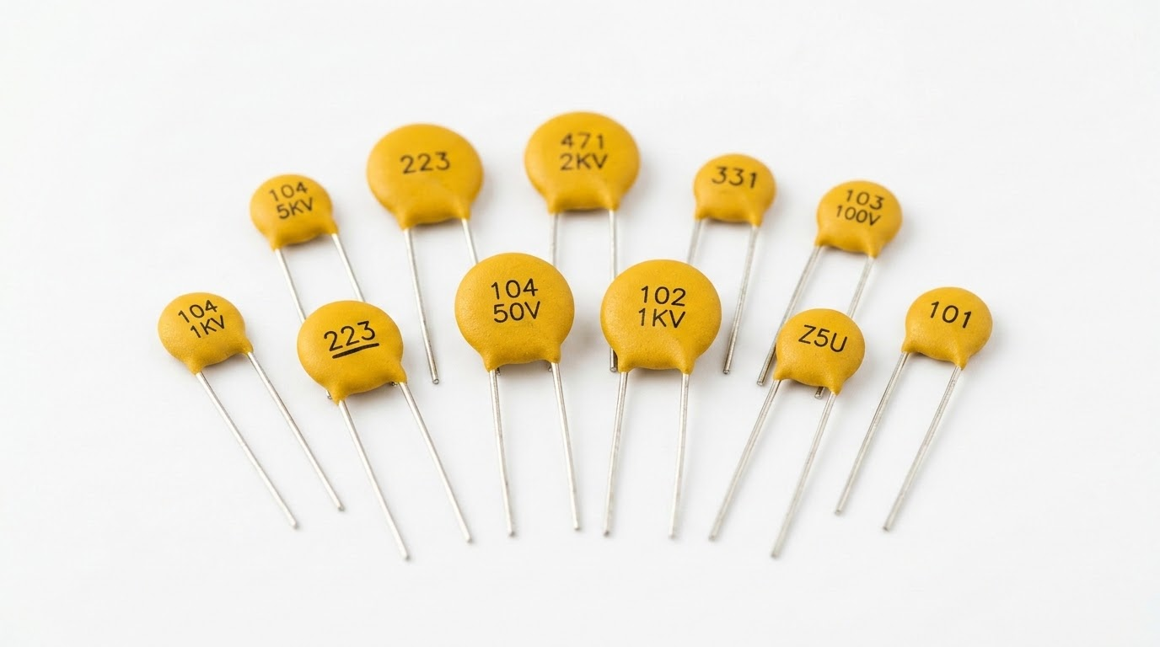
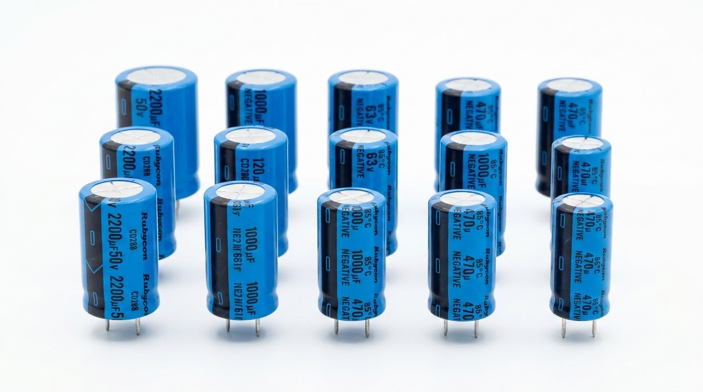
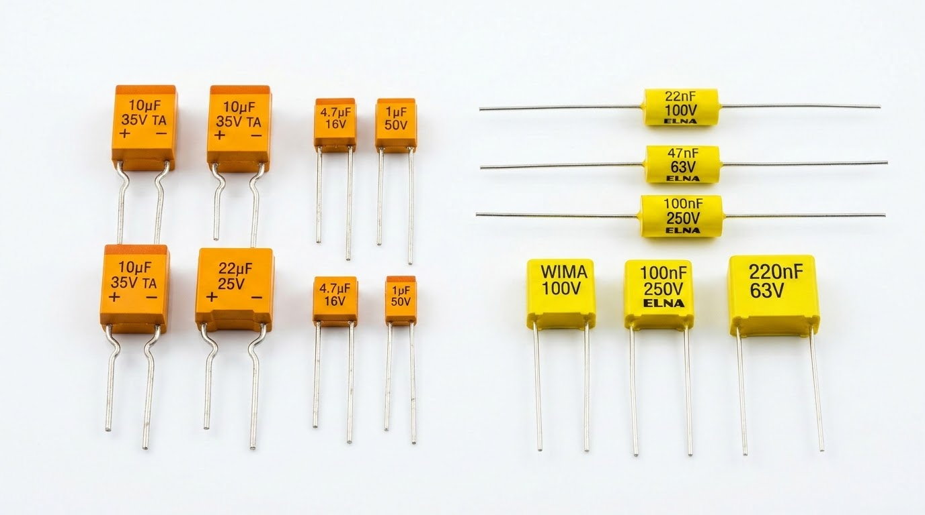
Types & Practical Applications of Capacitors
Capacitors are manufactured using various dielectric materials, each suited for specific frequency ranges, voltage ratings, and environmental conditions. Selecting the correct capacitor type is critical for the stability of robotic systems.
Ceramic Capacitors
Extremely common, compact, and non-polarized. Typically used for high-frequency noise filtering on DC motor terminals or microcontroller power pins.
Electrolytic Capacitors
Polarized components offering much higher capacitance values. Vital for power supply smoothing, stabilizing incoming voltage, and preventing reset loops under heavy loads.
Tantalum & Film Capacitors
Tantalum offers high capacitance in small footprints, ideal for compact robotics. Film capacitors provide precise capacitance values, perfect for analog timing and audio generation.
Practical Applications
Essential for noise filtering on motors, smoothing out DC ripple in power circuits, securing stable logic states in Arduino reset circuits, and configuring hardware-based debouncing for tactile pushbuttons.
Government of Sindh | University of Sindh | Module 7: Electronics for Arduino Programming

Slide 7
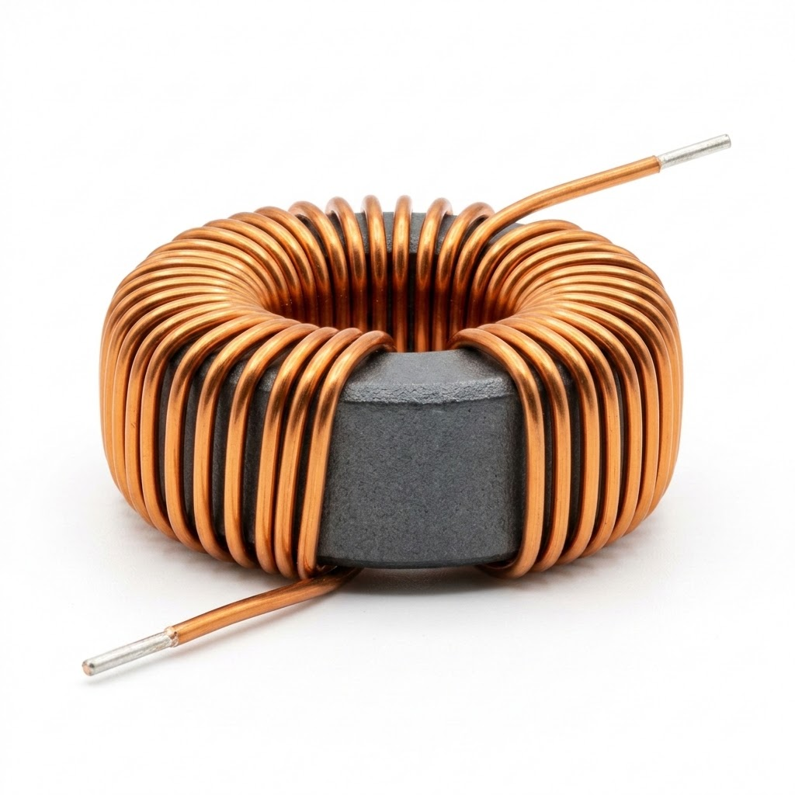
Introduction to Inductors
Theory & Operating Principles
An inductor is a passive electronic component that stores energy in a magnetic field when electric current flows through it. Physically, it consists of an insulated wire wound into a coil, often around a magnetic core (such as iron or ferrite) to increase the inductance.
Understanding Inductance: Measured in Henries (H), named after Joseph Henry. Inductance represents a component's capacity to store energy in a magnetic field and its ability to resist changes in electric current.
Coil Construction & Core Impact: The coil structure concentrates the magnetic field lines. Adding an iron or ferrite core inside the coil significantly boosts its magnetic permeability and energy storage capacity.
Circuit Symbols
Air-Core Inductor
Standard Plain Loops
Iron-Core Inductor
Straight Parallel Lines
Circuit Symbols: Standard schematic representations show a series of loops. Key variants include air-core (plain loops) and iron-core (loops with straight parallel lines on top) symbols, reflecting the physical design.
Physical Component Example
Coil & Core Construction
Physically, it consists of an insulated wire wound into a coil, often around a magnetic core (such as iron or ferrite) to increase the inductance.
Introduction of Electronics | Robotics and Automation Systems

Slide 8
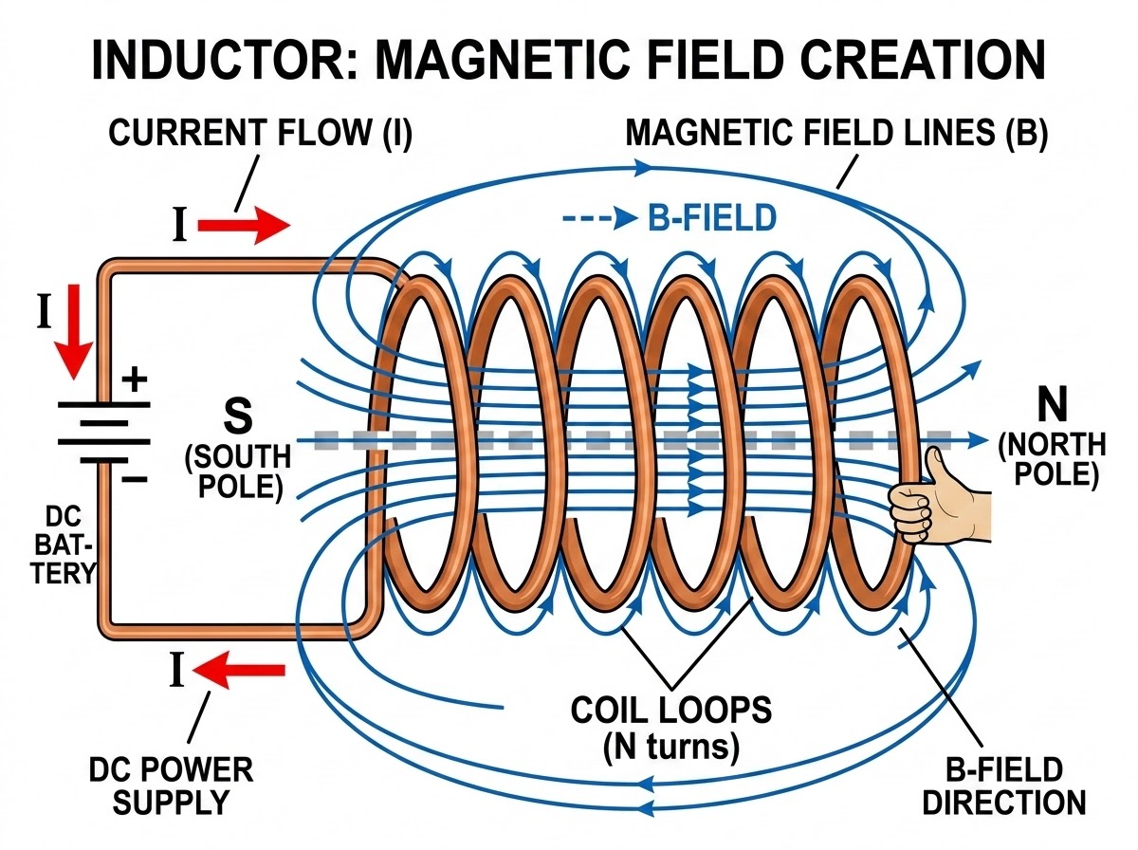
Working Principle of Inductors
Electromagnetic Induction
Magnetic Field Creation
When electrical current passes through the coil, it creates a magnetic field. If the current changes, the changing magnetic field induces a voltage (electromotive force) that opposes that very change, according to Lenz's Law.
Core Dynamics & Energy Storage
• Resisting Sudden Changes: An inductor acts like an inertia barrier for electric current. It allows steady DC to pass without resistance, but strongly opposes any sudden surge or drop in current.
• Energy Storage Mechanism: Unlike capacitors that store energy in electrical charges (electric fields), inductors store energy directly in the concentrated magnetic field wrapped around their coils.
The Mechanical Analogy
Think of an inductor as a heavy fluid flywheel in a water pipe. When you try to start the water, the flywheel blocks the flow. Once the flywheel is spinning, it tries to keep the water moving even if you close the valve, generating a pressure spike.
Introduction of Electronics | Robotics and Automation Systems

Slide 9
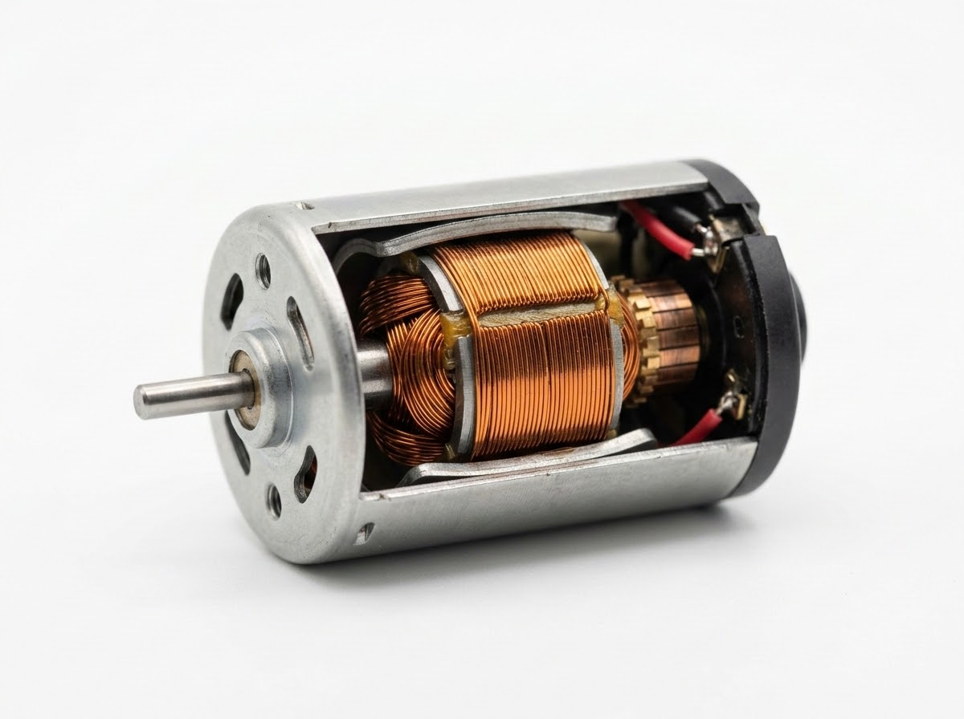
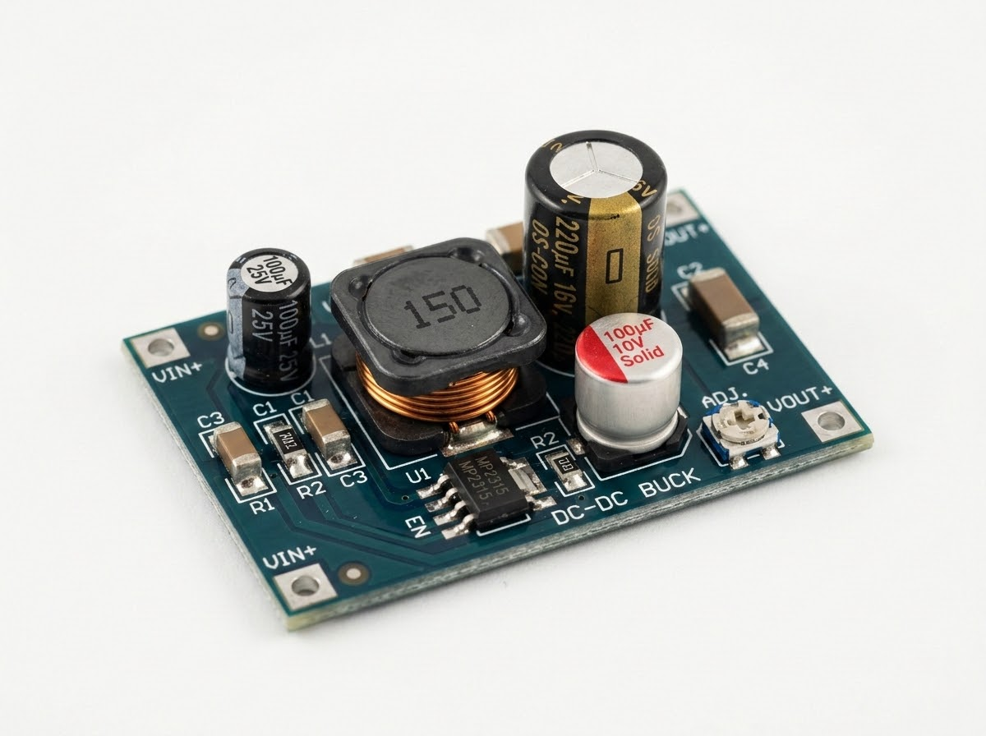
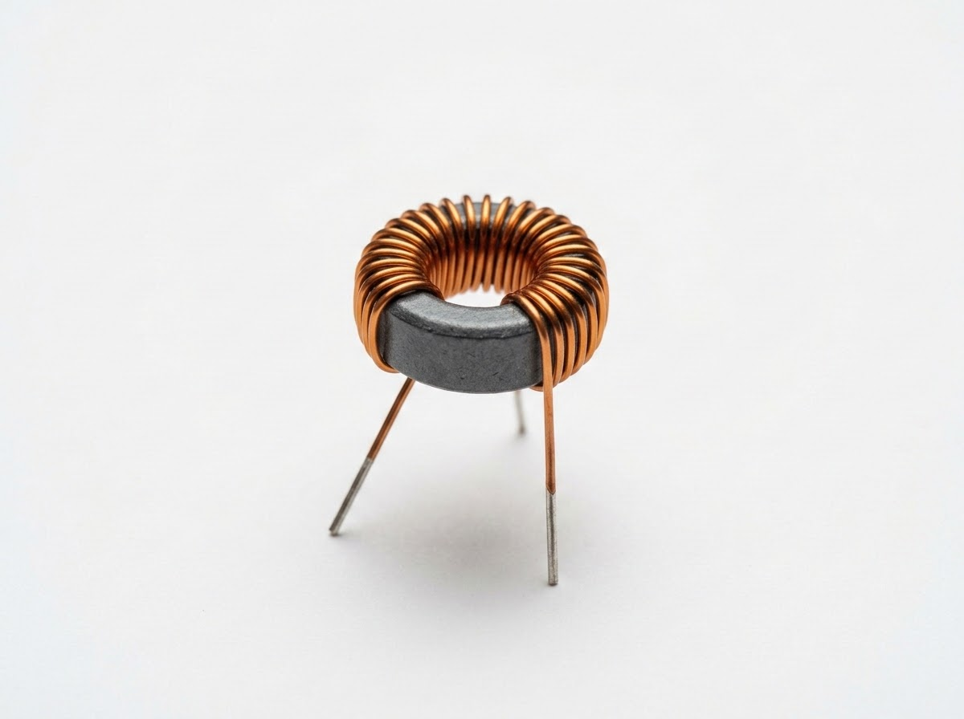
Practical Applications of Inductors
In robotics and power systems, inductors are critical for power management, motor control, noise isolation, and protecting sensitive digital circuits.
Motor Windings
Switching Regulators
LC Filters
DC Motors & Relays: Electric motors and mechanical relays are inherently highly inductive loads. Their coils of wire create strong magnetic fields to generate physical motion.
Switching Power Supplies: Inductors are core components in buck and boost converters, storing and releasing energy thousands of times per second to step voltages down or up efficiently.
Noise Filters & RF Chokes: Combined with capacitors, inductors form low-pass filters to block high-frequency electromagnetic interference (EMI) generated by motors, protecting the Arduino's logic lines.
Government of Sindh | University of Sindh

Slide 10
Capacitors vs. Inductors: Component Comparison
A direct comparison of energy storage, physical behavior, schematic symbols, and typical operations of these two essential passive components.
Capacitors
Inductors
Electrostatic Storage: Stores energy in an electric field created by accumulated charges, resisting sudden changes in voltage to act as a buffer.
Core Properties & Behavior:
DC & AC Response: Blocks direct current (DC) entirely once charged, but passes alternating current (AC).
Units & Symbols: Measured in Farads (F) and symbolized by two parallel plates.
Applications: Utilized for voltage smoothing, power conditioning, and noise filtering.
Electromagnetic Storage: Stores energy in a magnetic field created by current flow, resisting sudden changes in current to act as an inertia barrier.
Core Properties & Behavior:
DC & AC Response: Passes steady direct current (DC) freely, but blocks high-frequency alternating current (AC).
Units & Symbols: Measured in Henries (H) and symbolized by a series of coiled wire loops.
Applications: Utilized for current regulation, switching power converters, and motor electromagnetics.
Module 7: Electronics for Arduino Programming | Robotics and Automation Systems

Slide 11

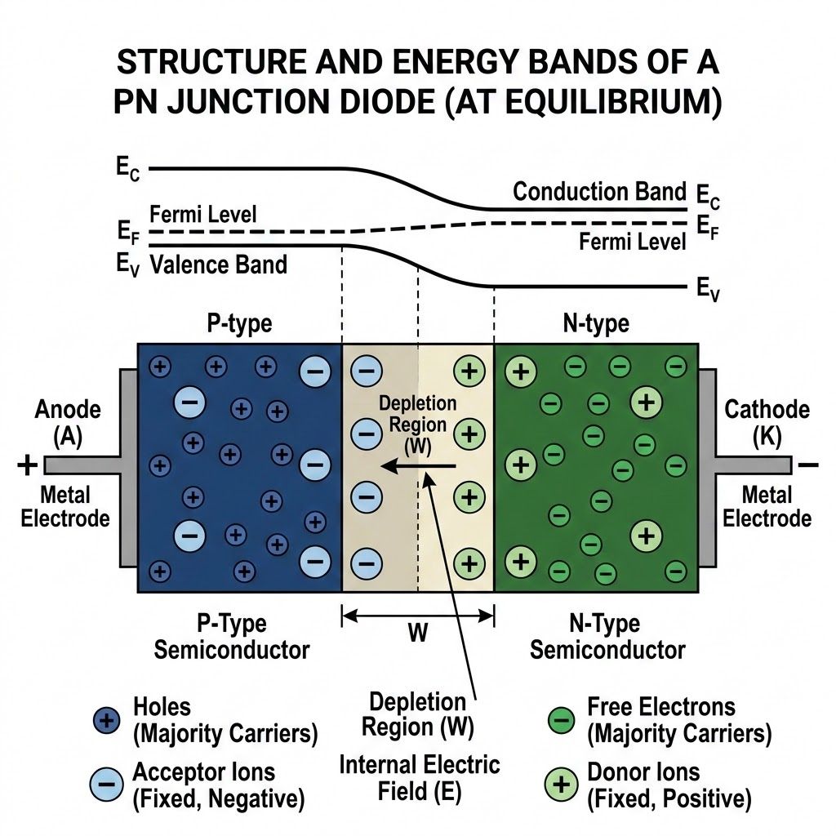
Introduction to Diodes
Semiconductor Basics & One-Way Flow
“A diode acts as an electrical one-way check valve, permitting current to flow easily in one direction while blocking reverse flow to protect sensitive components.”
Semiconductor Materials: Constructed by joining P-type material (rich in positive 'holes') and N-type material (rich in negative electrons).
The PN Junction: The contact boundary forms a 'depletion region' barrier that restricts natural electron flow until a specific voltage threshold is applied.
One-Way Flow Principle: Conventional current can only flow from the Anode (positive) to the Cathode (negative). Reverse flow is blocked.
Schematic Symbol: A triangle pointing to a vertical line, where the triangle represents the permitted flow direction and the flat line symbolizes the block.
Introduction of Electronics | Robotics and Automation Systems

Slide 12
Forward Bias vs. Reverse Bias: Current Behavior Under Voltage
The behavior of a diode is entirely determined by the electrical polarity and magnitude of the voltage applied across its terminals.
Forward Bias (Conducting)
Reverse Bias (Blocking)
When the positive terminal of a voltage source is connected to the Anode and the negative to the Cathode, the diode is forward-biased. The depletion region collapses, enabling current flow.
Key Behavior:
Requires minimum forward voltage of ~0.7V to conduct.
Results in a constant 0.7V drop across the junction.
When polarity is reversed, the depletion region widens, creating massive internal resistance that blocks current. The diode acts like an open switch, protecting upstream circuits.
Breakdown Voltage:
Excessive reverse voltage causes the junction to fail.
A massive, destructive reverse current flows, which must be avoided.
Current Flows (I > 0)
Current Blocked (I ≈ 0)
P-Type
N-Type
P-Type
WIDE
BARRIER
N-Type
Collapsed Depletion Region
Widened Depletion Region
Module 7: Electronics for Arduino Programming | Robotics and Automation Systems

Slide 13

Topic 2 — Inductors
DEFINITION
CONSTRUCTION & PHYSICS
METRICS & SCHEMATIC
"An inductor is a passive electronic component that stores energy in a magnetic field when electric current flows through it."
Crucial for filtering signals, managing alternating currents (AC), and blocking high-frequency noise in robotic control circuitry.
Coil Construction
Typically built as a conducting wire wound into a coil around an air or ferromagnetic core.
STANDARD UNIT
HHenry
Magnetic Field Generation
Current flow induces a proportional magnetic flux. Any change in current is met with an opposing electromagnetic force (EMF).
SCHEMATIC SYMBOL
L
Introduction of Electronics | Robotics and Automation Systems
07

Slide 14
Practical Applications of Diodes in Arduino Protection Circuits
Diodes are the essential bodyguards of any microcontroller-based system, preventing physical damage from reverse-polarity errors, electrostatic discharge, and inductive kickback.
Flyback Diode
Motor Protection
Reverse Polarity
Input Battery Security
ESD Clamping
I/O Pin Safeguarding
Inductive components like motors and relay coils generate massive voltage surges when turned off. Placing a reverse-biased diode (flyback diode) in parallel with the motor shunts these dangerous spikes safely back into the coil, bypassing and protecting the Arduino.
Placing a series diode at the main power input blocks current flow entirely if a battery or power supply is connected backward, immediately saving the Arduino from a fatal short circuit.
Shunting transient electrostatic spikes on I/O pins directly to VCC or GND before they can reach the sensitive silicon inside the microcontroller chip.
Module 7: Electronics for Arduino Programming | Robotics and Automation Systems

Slide 15




Introduction to LEDs: Light Emitting Diode Working Principles
TYPICAL LED EMISSION SPECTRUMS
Light Emitting Diode Working Principles
A Light Emitting Diode (LED) is a specialized active semiconductor diode designed to emit visible light (photons) when a forward-biased current flows through it.
Electroluminescence: LEDs operate on the principle of electroluminescence. When forward voltage is applied, electrons cross the PN junction and recombine with electron holes. This transition releases energy in the form of light photons instead of heat.
RED
660 nm
GREEN
565 nm
BLUE
470 nm
Efficiency & Advantages: Extremely efficient compared to incandescent bulbs. They consume up to 90% less energy, generate virtually no heat, are highly resistant to vibration, and possess an operational lifespan exceeding 50,000 hours.
SCHEMATIC SYMBOL
A
K
Color Determination: The color of the light is not created by dyed plastic casings, but by the physical material of the semiconductor crystal (e.g., Gallium Phosphide for green, Indium Gallium Nitride for blue/white), which dictates the energy gap and photon wavelength.
Module 7: Electronics for Arduino Programming | Robotics and Automation Systems

Slide 16
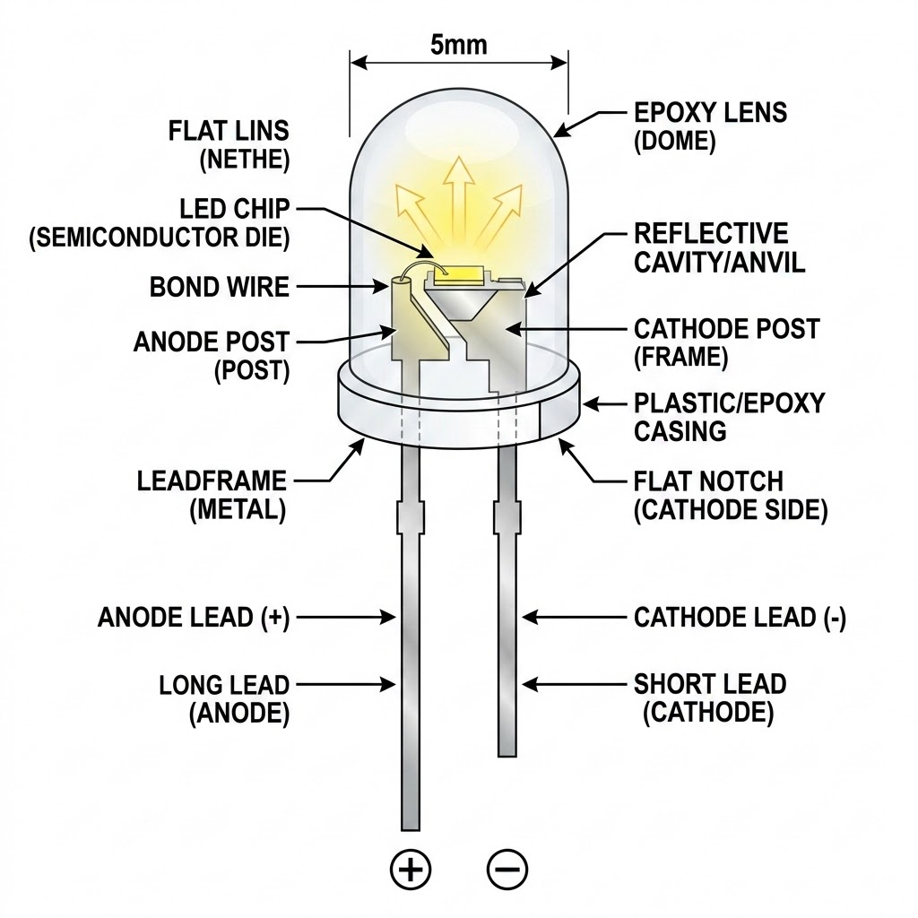
LED Polarity & Electrical Characteristics
IDENTIFYING PIN POLARITY
LEDs are highly polarized. Connecting them backward blocks current and prevents illumination.
• Anode (+): The positive terminal, identified by the longer physical leg.
• Cathode (-): The negative terminal, identified by the shorter physical leg and a flat notched edge on the rim of the plastic LED lens.
ELECTRICAL CHARACTERISTICS
Forward Voltage (Vf) variations: Different colors require different voltages to conduct and emit light:
- Red / Yellow: Low forward voltage (~1.8V to 2.2V).
- Green / Blue / White: High forward voltage (~3.0V to 3.4V).
Maximum Current: Most standard 5mm LEDs have a strict continuous current rating of 20mA. Exceeding this limit leads to immediate thermal runaway and permanent failure.
Introduction of Electronics | Robotics and Automation Systems

Slide 17
The Current Limiting Resistor
Because a forward-biased LED has virtually no internal resistance, connecting it directly to an Arduino pin outputting 5V will draw excessive current, instantly destroying the LED and potentially burning out the Arduino's output pin. A series current limiting resistor is absolutely mandatory.
Arduino Series LED Circuit
Limiting Formula
R = (Vs - Vf) / If
Vs = Source (5.0V) | Vf = LED (2.0V) | If = Current (0.02A)
Step-by-Step Solution
1. Voltage across resistor: VR = 5.0V - 2.0V = 3.0V
2. Solve for resistance: R = 3.0V / 0.02A = 150 Ω
The Standard Choice: 220 Ω
While 150 Ω is the safe minimum, 220 Ω is standard. It limits current safely to ~13.6mA, extending LED operational life and protecting the Arduino.
I = 20mA
R = 220 Ω
5V PIN
LED
Vf = 2.0V
GND
Module 7: Electronics for Arduino Programming | Robotics and Automation Systems

Slide 18
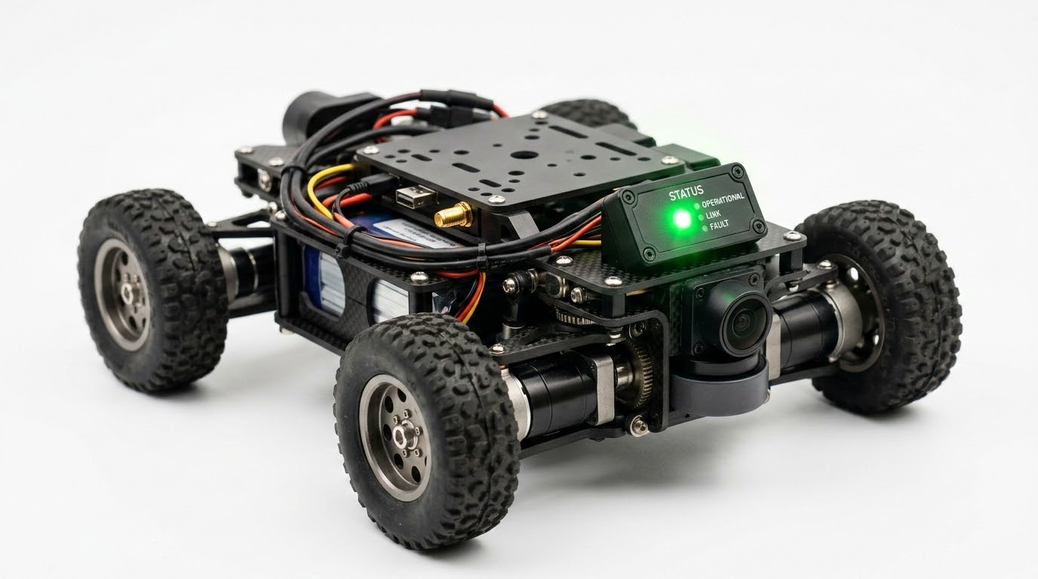
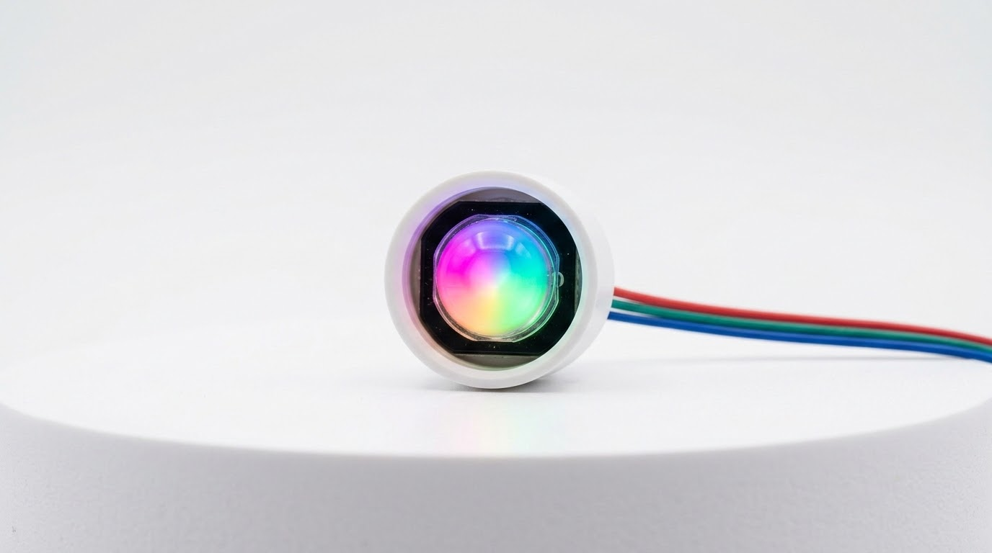
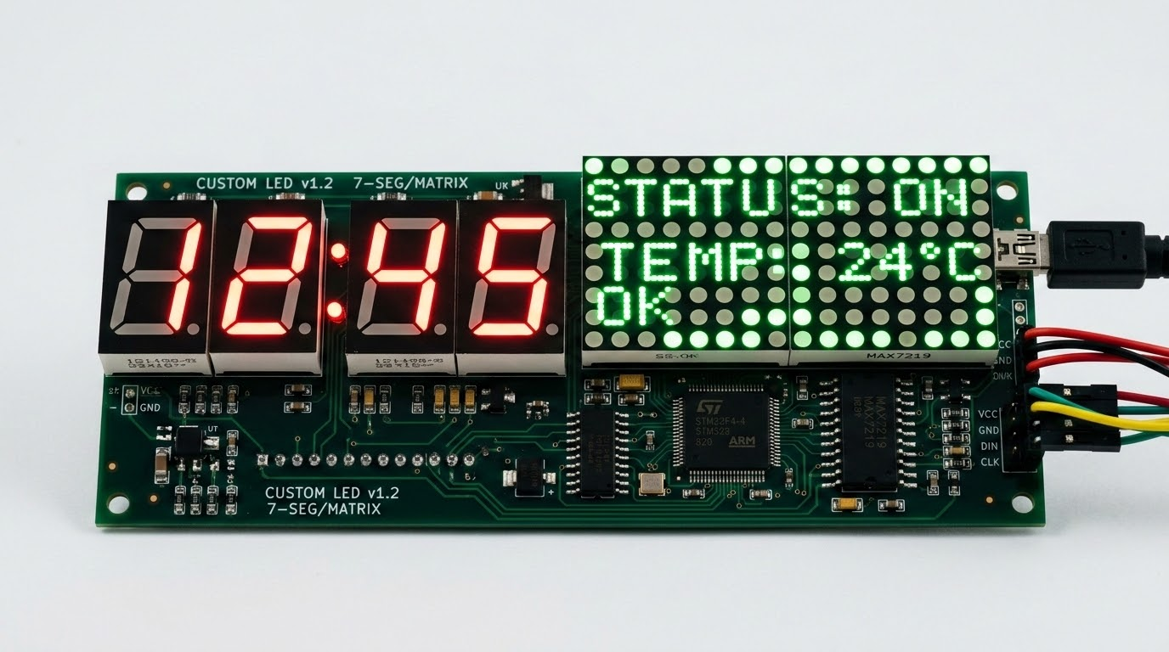
Practical Applications of LEDs in Robot & Indicator Systems
LEDs are the primary communication tools for robots, translating complex code execution states and analog sensor values into immediate, visible light feedback.
Visual Status Indicators
Multi-Color RGB Feedback
Custom Display Panels
Singly configured LEDs indicate main system status: continuous ON confirms power, flashing indicates active sensor telemetry, and fast flashing alerts of low battery or errors.
RGB LEDs mix red, green, and blue light inside a single housing. Using PWM to control intensity allows robots to generate millions of colors for proximity or temperature states.
Multiplexed matrix displays and 7-segment panels display numbers, error codes, or alphanumeric messages. Grouped LEDs can also simulate automated systems like traffic lights.
Government of Sindh | University of Sindh

Slide 19
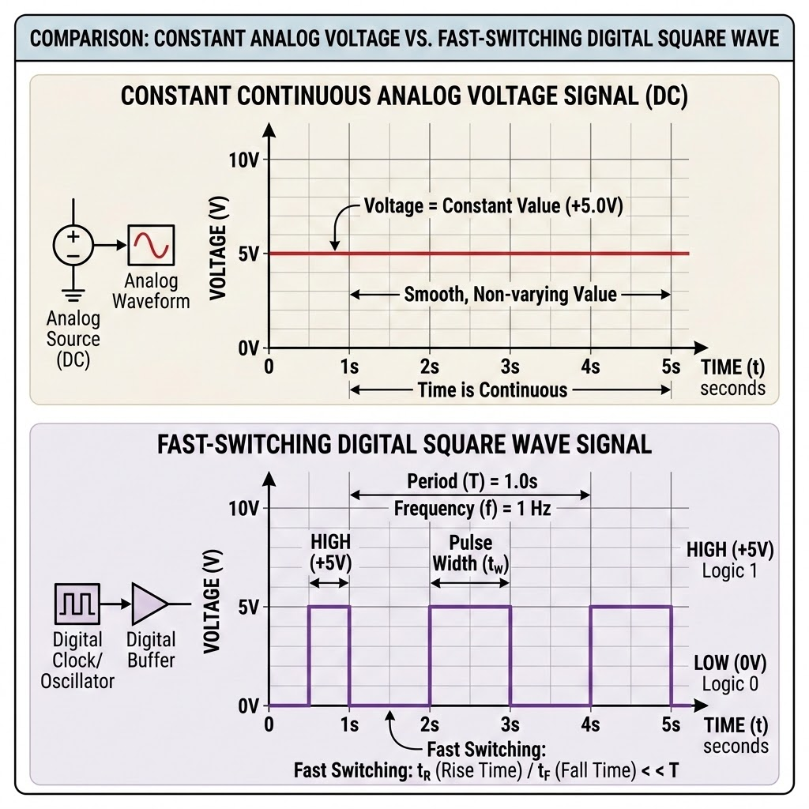
Topic 5: Introduction to PWM & Duty Cycle
Core Definition
Pulse Width Modulation (PWM) is a highly efficient technique used to simulate a variable analog voltage using a purely digital, binary power source.
Signal Comparison: Analog vs. Digital Square Wave
The Digital Voltage Limitation: Microcontrollers like the Arduino are digital systems; output pins can only be set to strictly HIGH (5V) or strictly LOW (0V). They cannot naturally output true intermediate voltages.
How PWM Works: PWM simulates intermediate voltages by switching a digital pin HIGH and LOW at an extremely fast frequency. The physical load averages this rapid switching into a steady, simulated voltage level.
Efficiency Advantage: Traditional regulators act like variable resistors, wasting excess energy as heat. PWM controllers are extremely efficient because the switching transistor is either fully ON (near-zero resistance) or fully OFF (zero current).
Introduction of Electronics | Robotics and Automation Systems

Slide 20
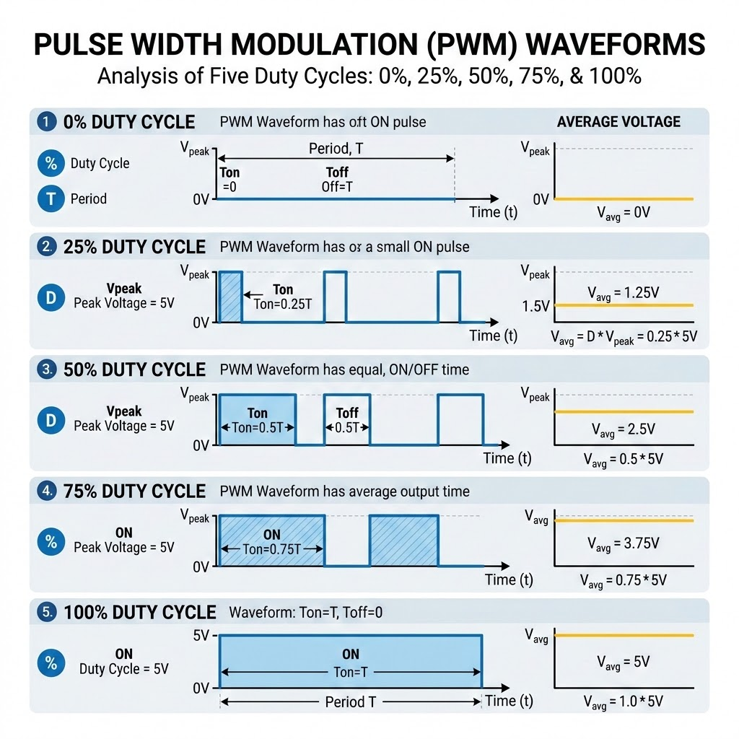
Duty Cycle Visualized: 0% to 100% Control & Voltage Calculations
Understanding Duty Cycle
The Duty Cycle is the percentage of time that a digital signal is HIGH (active) during a single full cycle. By adjusting this duty cycle, we directly scale the average output voltage.
Vavg = Vcc × (Duty Cycle / 100)
Key Parameters & Calculations:
Vcc = Digital High Level (5.0V for standard Arduino boards)
Examples: 25% Duty Cycle = 1.25V | 50% = 2.5V | 75% = 3.75V
Switching Frequency & Stability
Arduino PWM frequencies typically range from ~490Hz to 980Hz.
This means the signal repeats 490 to 980 times per second, ensuring smooth, flicker-free operation for motors, LEDs, and automation systems.
Module 7: Electronics for Arduino Programming | Robotics and Automation Systems

Slide 21
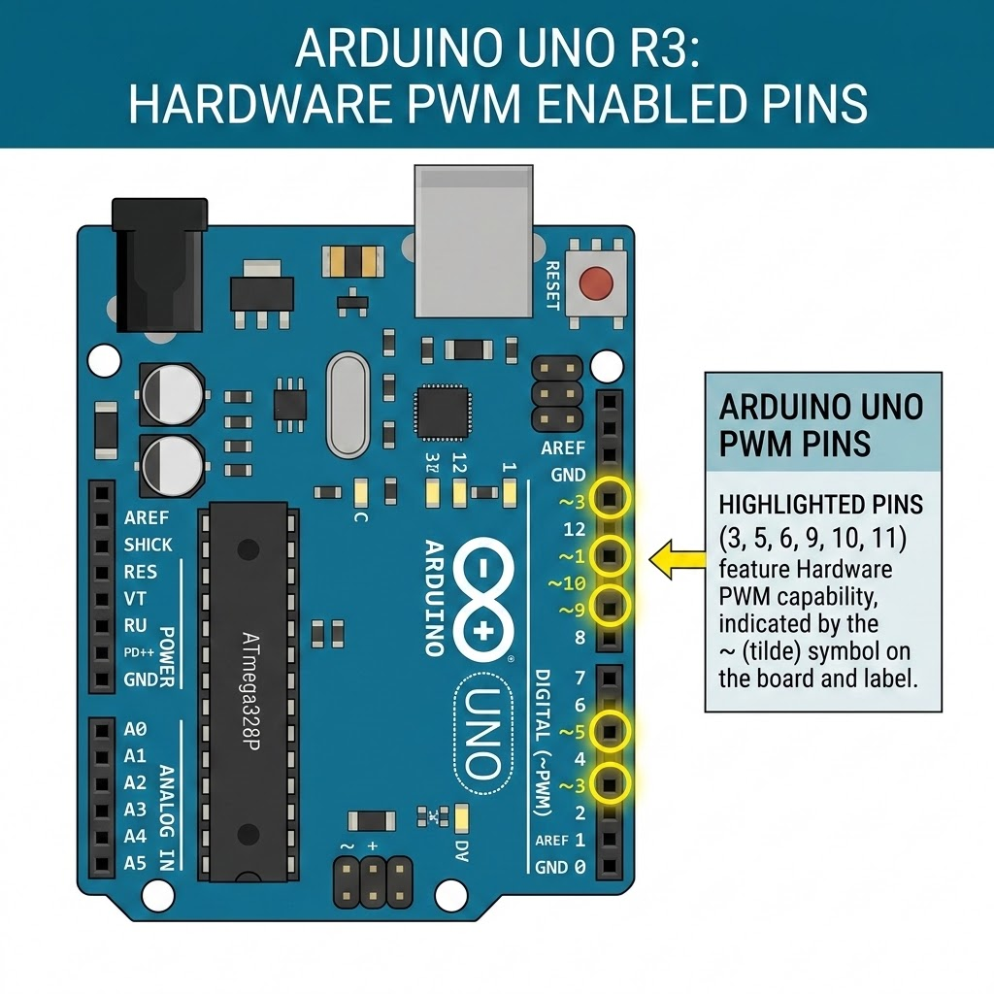
Implementing PWM in Arduino
The Arduino IDE dramatically simplifies PWM generation, utilizing built-in microcontroller timers to automate the high-speed switching process.
Identifying PWM Pins
Not all digital pins on the Arduino Uno support PWM. Only pins explicitly marked with a tilde symbol (~) have hardware PWM timers: Pins 3, 5, 6, 9, 10, and 11.
The analogWrite() Function
Generates a PWM signal on the specified pin. analogWrite(pin, value); where value is an 8-bit scale ranging from 0 to 255.
value = 0 maps to 0% Duty Cycle (constant 0V)
value = 127/128 maps to ~50% Duty Cycle (simulating 2.5V)
value = 255 maps to 100% Duty Cycle (constant 5V)
Under the Hood: Once called, independent hardware timers continue generating the signal in the background without blocking code execution.
Module 7: Electronics for Arduino Programming | Robotics and Automation Systems

Slide 22
Practical Applications of PWM in Motor Speed and LED Control
PWM is the universal standard for power control in mechanical and electrical systems, allowing precise control of motion, illumination, and audio.
LED BRIGHTNESS FADING
DC MOTOR SPEED CONTROL
SERVO ANGLE POSITIONING
Changing the duty cycle adjusts the average current flowing through the LED, controlling its brightness.
The switching is so fast that human Persistence of Vision averages the light pulses, preventing flickering.
Direct connection to a motor driver allows PWM to smoothly control the speed of a DC motor by varying the average motor voltage.
This technique avoids the severe power loss that occurs with series resistors.
Servos do not use PWM for power, but for communication.
The width of a periodic 50Hz PWM pulse (typically 1ms to 2ms) maps directly to a specific physical rotation angle (e.g., 1ms = 0°, 2ms = 180°).
Module 7: Electronics for Arduino Programming | Robotics and Automation Systems

Slide 23
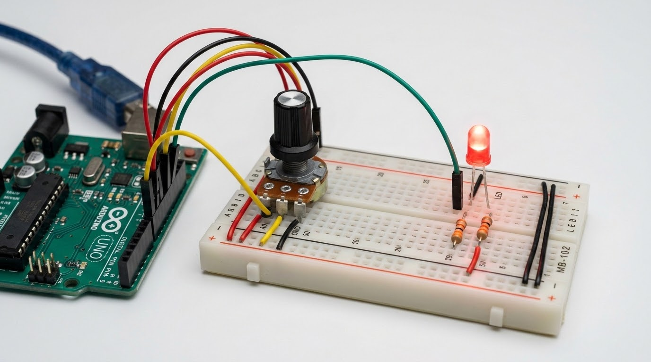
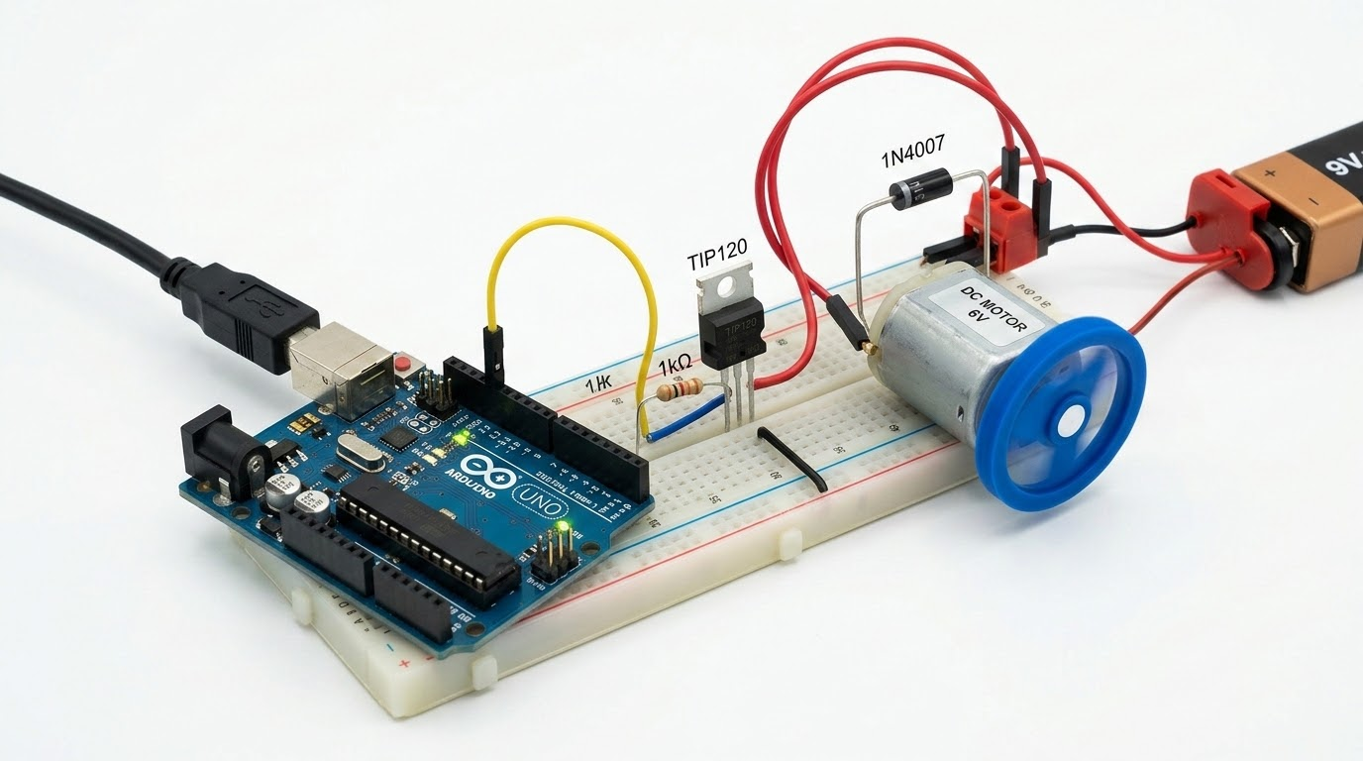
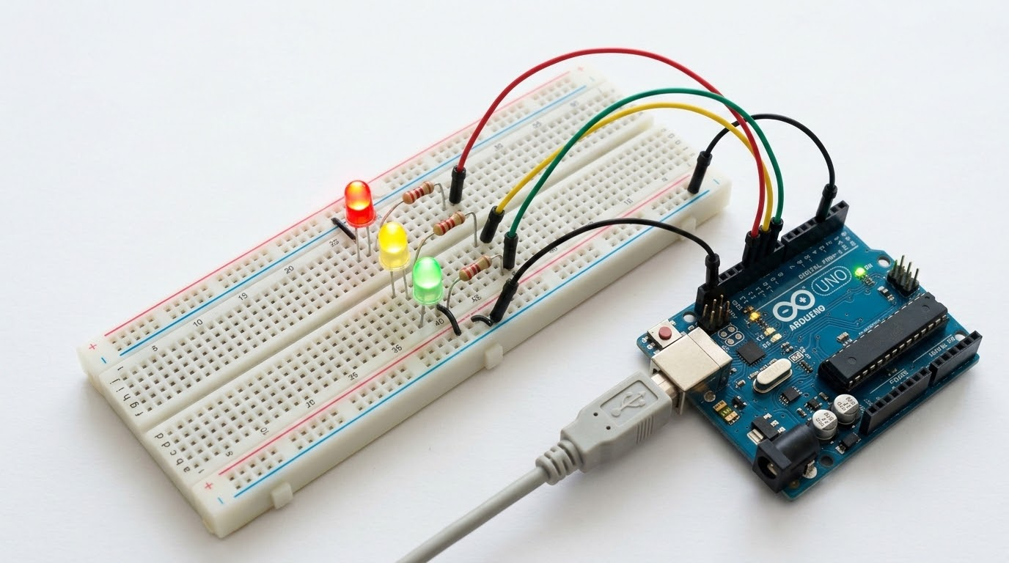
Real-World Arduino Projects
Let's explore foundational beginner circuits that demonstrate how passive components, semiconductor protective barriers, and digital modulation interact in real-world systems.
1. LED Dimmer
2. Flyback Motor Driver
3. Traffic Light Controller
Reads a variable analog voltage from a potentiometer (0V-5V, analogRead range 0-1023), uses the map() function to scale to 0-255, and outputs a PWM signal to smoothly dim an LED.
Implements a high-current transistor or MOSFET switch to control a heavy DC motor from an Arduino pin. It requires a parallel flyback diode to route inductive voltage spikes safely away from the transistor.
Replicates a city traffic signal with Red, Yellow, and Green LEDs, each wired to digital output pins through 220-ohm current limiting resistors, managed by structured state-machine loops.
Module 7: Electronics for Arduino Programming | Robotics and Automation Systems

Slide 24
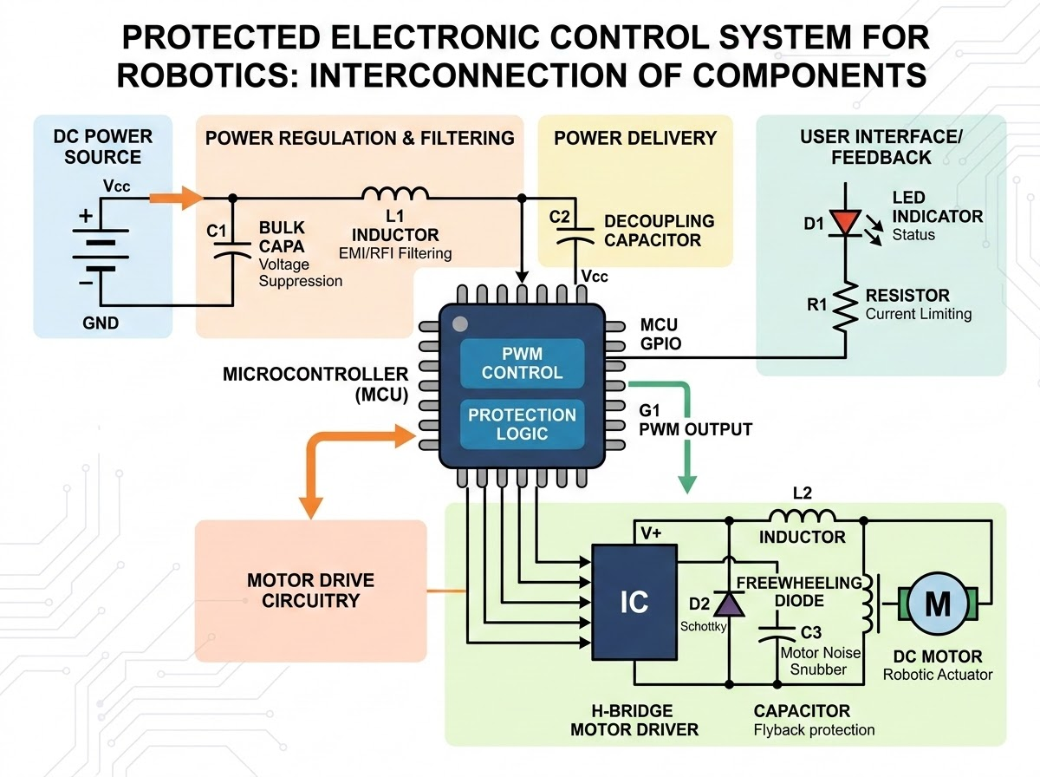
Module 7 Summary: Integrated Component Synthesis
Designing reliable robotic hardware requires a solid understanding of how passive components, semiconductor guards, and digital controllers interact.
• Power Stabilization: Capacitors serve as the primary reservoirs, smoothing voltage ripples and decoupling sensor lines from high-frequency power spikes.
• Actuation & Magnetics: Inductors wrapped inside motors and relay coils generate the electromagnetic fields needed for motion, but generate high-voltage spikes when deactivated.
• Active System Protection: Diodes act as essential system bodyguards, safely shunting inductive motor surges away from the Arduino and blocking reverse-polarity battery damage.
• Visual Telemetry: LEDs provide efficient, low-power visual indicators, safely guarded by calculated current limiting series resistors.
• Emulated Actuation: Pulse Width Modulation (PWM) acts as the bridge between digital code and analog actuation, controlling motor speed and LED dimming efficiently.
Module 7: Electronics for Arduino Programming | Robotics and Automation Systems

